Slide 1

ENHANCING SPEECH RECOGNITION SCALABILITY AND RESILIENCE THROUGH DECOUPLED ARCHITECTURE
Student:
Project ID:
Supervisor:
Tey Li Zhang Edmund
CCDS24-0015
Prof Chng Eng Siong
Notes:
Hello Prof. Chng and fellow students. I am Edmund, and today, I will be presenting my Final Year Project on enhancing speech recognition scalability and resilience through a decoupled architecture.

Slide 2
01
BACKGROUND
TABLE OF CONTENTS
02
SOLUTION
03
IMPLEMENTATION
04
CONCLUSION
2
Notes:
In this presentation, I will cover four main areas:
A background of the Automatic Speech Recognition System
The solution and
The implementation details
And finally I will conclude with the significance, future works and contributions to the project

Slide 3
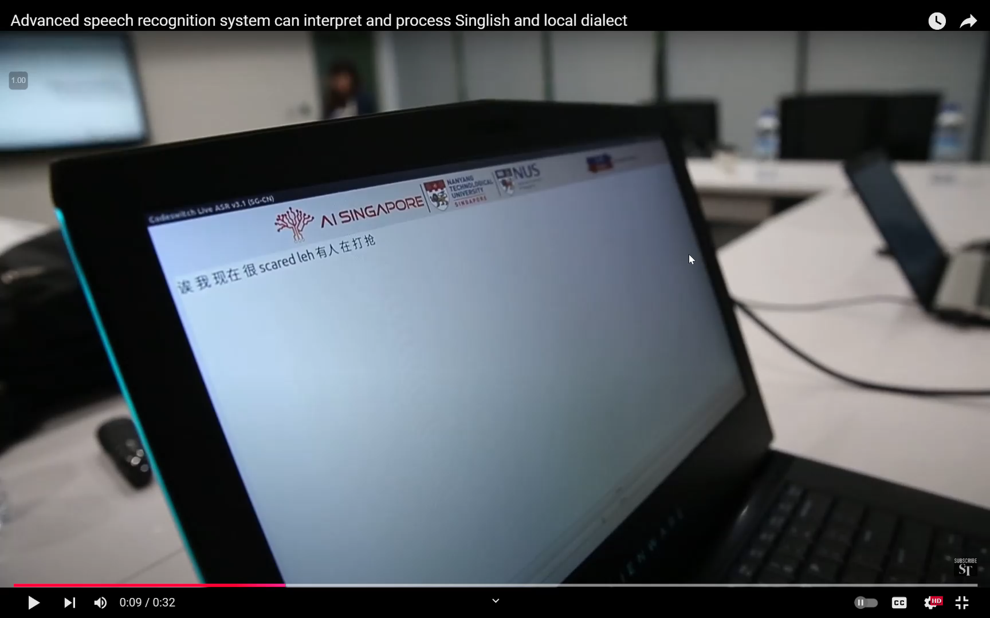
NTU Speech Lab ASR System
Provides live transcription for speech-to-text
Supports mixed-lingual transcription
Actively used by several users, including emergency call centres
BACKGROUND
3
Notes:
NTU speech lab has developed an automatic speech recognition system, or ASR system in short, which provides live transcription for human speech into readable text
it is capable of transcribing speech in multiple languages, like English and Chinese.
They have a few users using their live transcription service, including emergency call centers.

Slide 4







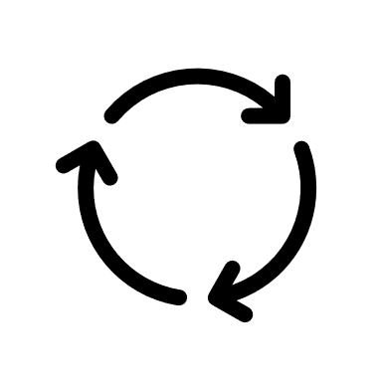
Previous Architecture
Client
Kubernetes
Client sends transcription requests to Live Processing Service
Live Processing Service routes audio data to Worker for processing
Worker returns results to Client
Live Processing Service
Worker
BACKGROUND
4
Notes:
The ASR system contains the live processing server and worker is containerised with docker and is deployed on Kubernetes, a container orchestrator which helps to manage the containers. The ASR system is deployed on cloud on AWS.
Let us now go through the live transcription flow of the system:
The client sends transcription requests a single instance of Live Processing Server
The Live Processing Service routes the audio data to a specific worker for processing.
The results are then returned to the user.
While functional, this system has several key limitations.

Slide 5
Limitations
Client
Kubernetes
Worker Failures
Single Point of Failure
Scalability Issues
Live Processing Service
Live Processing Service
Audio data not processed
No backup server
Live Processing Service
Tightly coupled
system
Worker
Worker
Complete service outage
Worker
Difficult to scale
Gap in transcription
BACKGROUND
5
Notes:
Firstly, the application is deployed on just one server resulting in a single point of failure. If that server fails, there is no backup, which could lead to a complete outage.
Secondly, the direct communication between the live processing server and the workers results in a tightly coupled system, making it hard to scale up and manage different traffic loads.
Thirdly, if a worker fails, such as due to a network issue, any in-progress audio processing is lost. This creates gaps in transcription and disrupts the service.
These challenges significantly affect both the system’s availability and the real-time nature of transcription services, particularly for critical applications like call centres.

Slide 6
Objective
Kubernetes
Improve Scalability & Resilience of ASR System
Live Processing Service
Live Processing Service
Live Processing Service
Single Point of Failure
Deployed Multiple Servers
No backup server
Worker
Worker
Worker
Scaling Based on Resource Usage
Complete service outage
BACKGROUND
6
Notes:
Therefore the objective of my project is to improve the scalability and resilience of NTU SpeechLab’s ASR system.
Firstly, to tackle the single point of failure from having only one live processing server, multiple servers were deployed and automatically scaled based on resource usage.

Slide 7

Objective
Objective
Kubernetes
Improve Scalability & Resilience of ASR System
Live Processing Service
Live Processing Service
Live Processing Service
Scalability Issues
Task Queue
Tightly coupled
system
Decoupling with Message Queue
Worker
Worker
Worker
Result Queue
Difficult to scale
BACKGROUND
7
Notes:
Secondly, to handle the scalability issue due to the tightly coupled architecture, we can decouple the system with rabbitmq, a message queue enabling asynchronous communication between the services. Audio data are sent to the task queue and the transcription results are sent to the results queue.

Slide 8



Objective
Kubernetes
Improve Scalability & Resilience of ASR System
Live Processing Service
Live Processing Service
Live Processing Service
Worker Failures
Task Queue
Audio data not processed
Implementing Worker Fault Detection and Recovery
Worker
Worker Manager
Worker
Worker Manager
Worker
Worker Manager
Result Queue
Redis
Gap in transcription
BACKGROUND
8
Notes:
Thirdly, to address the case of worker failures, a robust worker fault detection was implemented using a heartbeat mechanism, where the worker will periodically update its status to the worker manager. The worker manager will detect any missed heartbeats, and reassign workers to takeover the task.

Slide 9

Previous Implementation
Client
Kubernetes
Distributed log-based messaging system
Decouple Live Processing Service and Worker [1]
Live Processing Service
Kafka
Worker
Reference:
[1] T. Putra, “Deploying automatic speech recognition system for scalability, reliability, and security with kubernetes,” B.Eng. dissertation, Nanyang Technol. Univ., Singapore, 2023. [Online]. Available: https://hdl.handle.net/10356/171933.
SOLUTION
9
Notes:
Before we move on, let us explore the previous implementation by FYP student Tjandy have worked on the project, and he utilised Kafka, a distributed log-based messaging system to decouple the live processing service and worker components.
How does kafka works? Let us take a closer look.

Slide 10
Kafka in ASR System
Live Processing Service sends audio data
Topic: grouping of audio chunks
Partition: ordered sequence of audio chunks
Offset: position in partition
Topic
0
1
2
3
4
Live Processing Service
Worker
D
C
B
Partition 1
A
SOLUTION
10
Notes:
The Live Processing Service sends audio data in 1 second chunk to a Kafka topic.
A topic is a logical grouping of related messages and in this case, it is the 1s audio chunk labelled A, B, C and so on from the transcription task. Each topic is divided into one or more partitions, and each message within the partition has a position denoted by the offset. Like offset 0, 1 and 2 denoting position 0, 1 and 2 in the partition.

Slide 11
Kafka in ASR System
Live Processing Service sends audio data
Topic: grouping of audio chunks
Partition: ordered sequence of audio chunks
Offset: position in partition
Worker consumes audio data
Periodically commits offset to save progress
Topic
0
1
2
3
4
Live Processing Service
Worker
Partition 1
A
B
C
D
A
B
C
D
Commit Offset
SOLUTION
10
Notes:
Worker, read the audio chunks from the topic partition and process it for transcription. Periodically the workers commit the offset of the last processed audio chunk to keep track of the data they have processed.

Slide 12
Research Gaps
Worker fails before committing offset
Topic
0
1
2
3
4
Live Processing Service
Worker
Partition 1
A
B
C
D
A
B
C
D
Commit Offset
SOLUTION
11
Notes:
Let us explore the research gaps with using Kafka. What happens when the worker fails before saving its latest progress through committing the latest offset? In this example, worker finish processing audio chunk A, and commit the offset 0. It then proceeds to process audio chunk B, C and D.

Slide 13
Research Gaps
Worker fails before committing offset
Reprocessing of data → affecting accuracy and latency
Topic
0
1
2
3
4
Live Processing Service
Worker
Partition 1
A
B
C
D
B
C
D
SOLUTION
11
Notes:
If the worker fails before committing the latest offset, when the worker recovers, it will check back the offset and notice that it left off at offset 0. It assumes that only audio chunk at offset 0 was processed and it continues from offset 1. This leads to a reprocessing of audio chunk B, C and D affecting the transcription accuracy and latency.

Slide 14
Research Gaps
Single Partition → Ordering → Speech Context
Multiple Partitions → High Throughput → Unordered
Topic
0
1
2
3
4
Live Processing Service
Worker
C
E
B
F
Partition 1
A
D
0
1
2
3
4
Partition 2
0
1
2
3
4
Partition 3
SOLUTION
12
Notes:
Kafka is configured to use a single partition per topic to ensure ordering within the partition to maintain speech context.
However, one of kafka’s strength lies in its partitioned architecture, enabling high throughput through parallel processing across partitions. But this means that the audio chunks will be processed out of order.
For example, if the live processing service sends audio chunks to multiple partitions, notice that the order between the partition is not preserved.

Slide 15
Research Gaps
Single Partition → Ordering → Speech Context
Multiple Partitions → High Throughput → Unordered
Unable to use partitions for higher throughput
Topic
0
1
2
3
4
Live Processing Service
Worker
A
F
Partition 1
A
F
0
1
2
3
4
B
D
Partition 2
B
D
Worker
0
1
2
3
4
C
E
Partition 3
C
E
Transcription
Results
A
C
B
F
D
E
SOLUTION
12
Notes:
As a result, when multiple workers consume from different partitions concurrently, audio chunks may be processed out of sequence. In this example the worker process audio chunk A first then C then B and so on, disrupting the natural flow of speech. Therefore, we are unable to leverage on Kafka partitioned architecture for parallelism, defeating its main strength.

Slide 16

Research Gaps
Great work on decoupled architecture and security aspects
Unable to integrate improvements to current codebase
SOLUTION
13
Notes:
While Tjandy made significant contributions by decoupling the system architecture and incorporating strong security measures, the research team unfortunately did not have access to his project’s codebase to build upon those improvements.
This limitation, however, presented an opportunity to re-evaluate the architecture with a fresh perspective focusing on decoupling the components and dynamic scaling

Slide 17
Solution: RabbitMQ
Message ordering guarantees
Flexible acknowledgement mechanism
Simpler sequential processing
Acknowledged
Acknowledged
RabbitMQ
Worker
Task
Queue
A
B
C
D
Live Processing Service
A
B
C
Process
Audio Chunk
Send Audio Chunk
SOLUTION
14
Notes:
To address the research gaps identified, RabbitMQ was chosen as the message broker instead of Kafka.
RabbitMQ is a message queue that guarantees strict message ordering, which is crucial for preserving context in live transcription tasks.
It also offers a flexible acknowledgment system: producers can confirm once a message is sent, and
and consumers acknowledge messages only after successfully processing them.
Overall, RabbitMQ provides a simpler and more reliable approach for the sequential processing required in live transcription systems, while also making the system easier to maintain and operate.

Slide 18
New Architecture
Kubernetes
Worker Manager
Redis
Live Processing Service
Task Queue
Worker
Result Queue
SOLUTION
15
Notes:
Introducing the new architecture.
It has 6 main components:
1. The live processing service, which previously was known as the master pod
2. Worker
3. Task and Results Queue
5. Worker Manager
6. Redis, an in memory data store
Now I will introduce to you how does live transcription works with this new architecture

Slide 19
Live Transcription Flow
Kubernetes
Client
gRPC
AllocateWorker
Worker Manager
Get
Idle Workers
Redis
gRPC
ConsumeTask
Websocket
Connection
Update
State
Create Queues
Live Processing Service
Task Queue
Busy
Worker
Idle
Worker
Result Queue
Idle
Worker
IMPLEMENTATION
16
Notes:
Firstly, The client establishes a WebSocket connection to the Live Processing Service for their transcription.
Upon receiving the connection, the Live Processing Service creates a result and task queue.
The Live Processing Service invokes the Worker Manager’s gRPC API to allocate a worker for the task. I will explain later on, what is gRPC.
The Live Processing Service also starts placing audio data into the task queue.
The Worker Manager checks Redis for an idle worker with the requested ASR model and assigns it to the task. The worker is notified via a gRPC call.
The worker updates its state in Redis to BUSY and begins processing the audio data.
Transcription results are sent to the result queue as the audio is processed.
The Live Processing Service retrieves these partial results from the result queue and streams them back to the client via the WebSocket connection.

Slide 20

Horizontal Scaling
Kubernetes
Client
Client
Worker Manager
Redis
Client
Live Processing Service
Live Processing Service
Busy
Worker
Live Processing Service
Task Queue
Result Queue
Idle
Worker
IMPLEMENTATION
17
Notes:
To scale the services, autoscaling was implemented. It was achieved using Kubernetes Horizontal Pod Autoscaling, which monitors resource metrics such as CPU and memory usage.
Let us zoom in and focus on the client and live processing service for the example
As client traffic increases, the resource usage of the live processing service rises accordingly.
In response, Kubernetes automatically scales up the number of pods to handle the higher load.

Slide 21
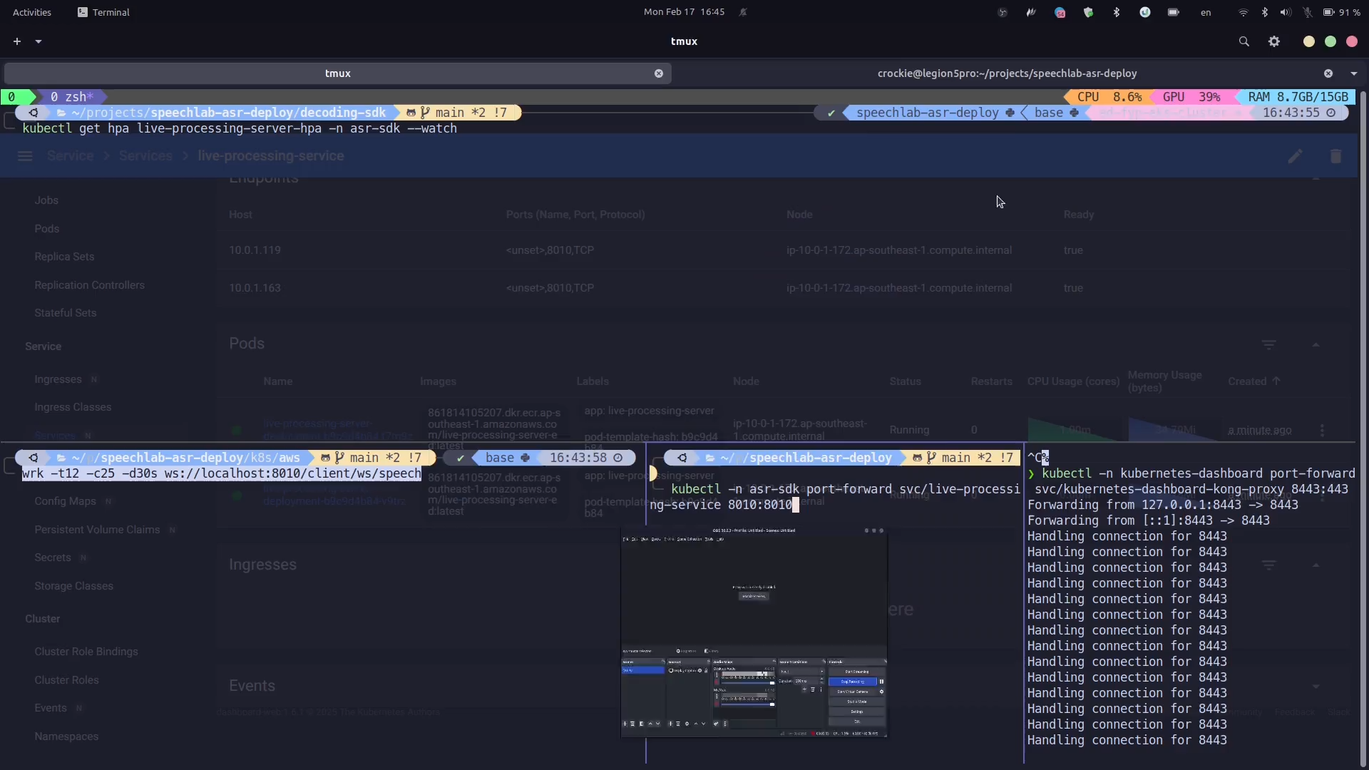
Notes:
The system is automatically scaled based on resource usage.
Initially, we can observe from the the live processing server is utilizing just 1% CPU and 14% memory.
To simulate client traffic, we use the CLI tool shown at the bottom left, which establishes 25 concurrent connections to the service for 30 seconds.
As the load increases, we see a spike in CPU usage.
In response, the system scales up the number of live processing server, which is reflected in the dashboard.

Slide 22
Dynamic Scaling
Kubernetes
Client
Worker Manager
Redis
Dynamic
Scaling
Live Processing Service
Task Queue
Busy
Worker
Idle
Worker
Result Queue
Idle
Worker
Idle
Worker
IMPLEMENTATION
18
Notes:
To scale the workers, a dynamic scaling policy was implemented. The Worker Manager monitors the workers and ensures the number of idle workers meets the scaling target.
In this example, with one busy worker and a target of two idle worker, it scales up by adding another, resulting in one busy and two idle workers.

Slide 23
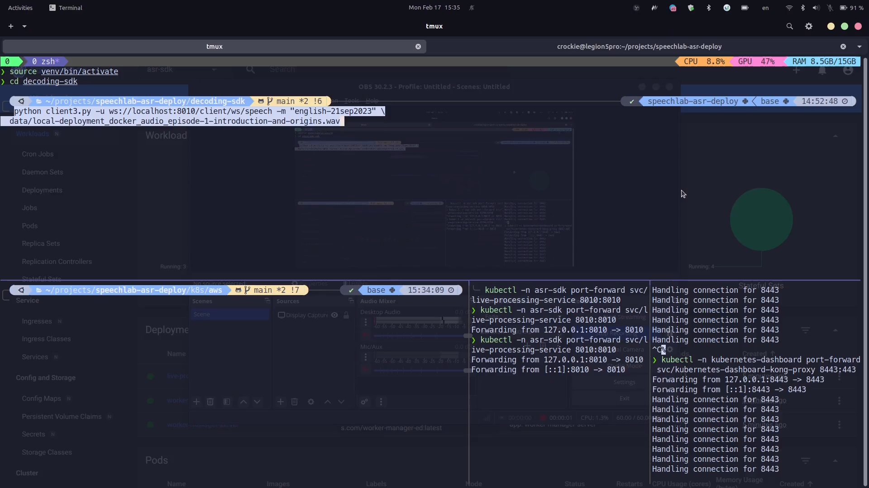
Notes:
Here, a client initiates a transcription request, and the application begins streaming results.
The scaling target for the workers is set to maintain two idle workers.
From the logs, we observe it detects one idle and one busy worker, prompting it to scale up to meet the target.
As a result, the number of worker increases from two to three.

